Slide 1
From Logs to Lumber: NHLA Yield Analysis
Tony Parks
Strategic Adviser,
NHLA Yield Analysis
Notes:
Good Morning, My Name, My Experience, The reason I am here.
Before we get into the presentation let me ask a question.
If someone was to walk into this room and offer you the opportunity to increase your annual profitability by $400,000 without changing anything but processes and procedures, no capital expense, no increase in payroll, How would you respond? I am here to introduce you to that opportunity.

Slide 2
“For over 115 years, NHLA’s Inspection Services have played a key role in ensuring our members’ success. I am proud to announce the next generation of member value, the NHLA Yield Analysis to continue that tradition of service to the hardwood industry.”
Darwin Murray
President,
NHA Board of Managers
Notes:
Since 1898,the NHLA Rules and the Inspection Services have been instrumental to the success of the hardwood industry.

Slide 3
Markets are Changing
From Log to Lumber: NHLA Yield Analysis
What is yield analysis
Inspection services – 200 years experience
Take the time to know what we don’t know
New Competitors
Price increases for raw materials
Competition for logs
Notes:
But we also recognize that the lumber market has changed dramatically… we faced with new competitors for natural resources. We face price increases for raw materials and increased competition for logs.

Slide 4
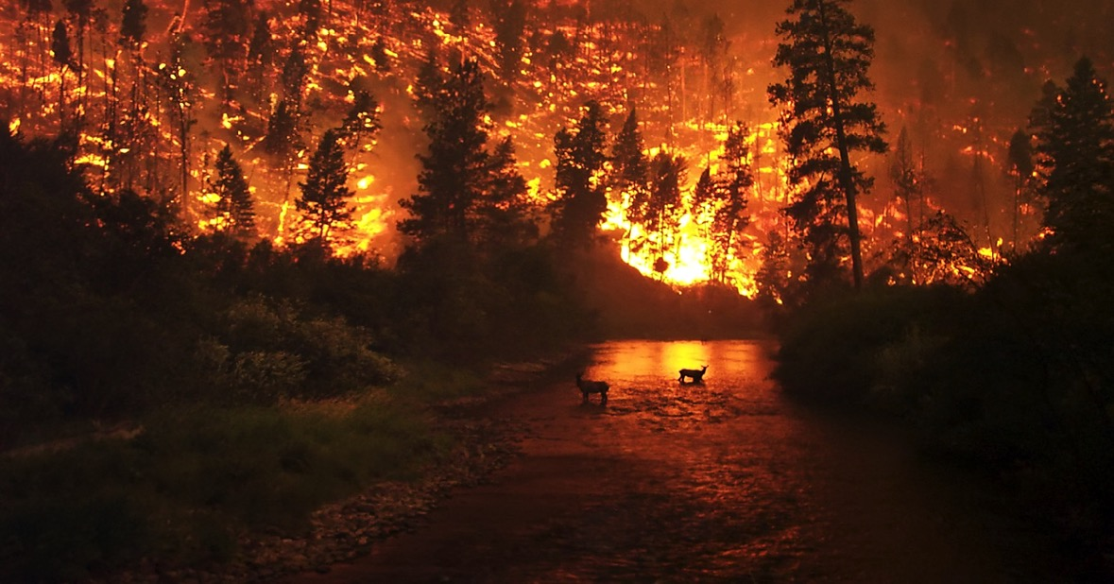
And I won’t even start talking bout the activists who would rather watch our hardwood fore
Notes:
And I am not even going to mention having to deal with activists who would rather watch our forests burn than allow proper forest management.

Slide 5
Notes:
Now when you see this picture….how many of you see lumber?
The NHLA Inspections Services has developed a process resulting in providing guidance to get more out of your logs
Higher yields, increased productivity and profitability. NHLA’s objective is to make our industry more competitive in global markets.

Slide 6
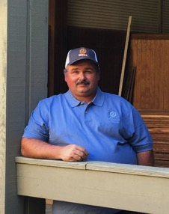
Notes:
What can do to make our members more money?

Slide 7
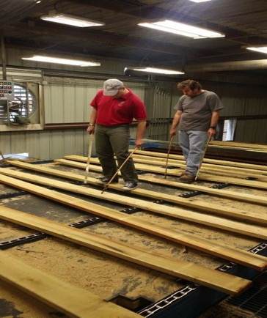
Why just grade the lumber?
Why not help
members improve
the Yield & Value of the lumber produced?
Notes:
As markets continue to change and the pressures on sawmillers increased, NHLA asked a very important question, why are we just grading lumber that comes off the chain …..?
We realized that because of the expertise of our inspectors, we could do more.
Why not look for ways to help our members recover recover more profitability from our logs?

Slide 8
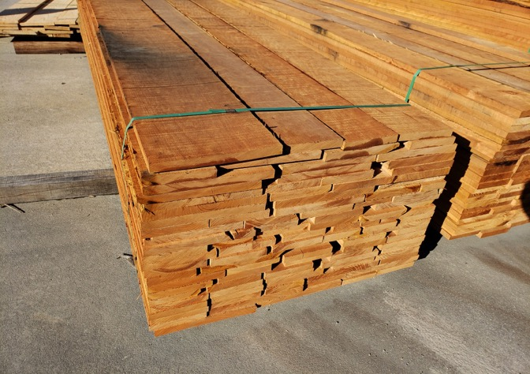
Higher Utilization of Raw Materials =
Notes:
Because we all know that higher yield equals increased profitability.
Our objective is not to make boards, but to make money.

Slide 9
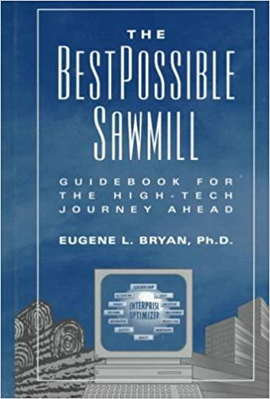
“If you do not measure it,
you cannot manage it.”
by Eugene Bryant

Slide 10
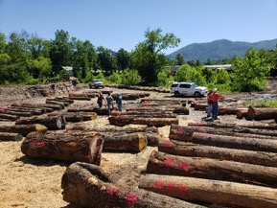
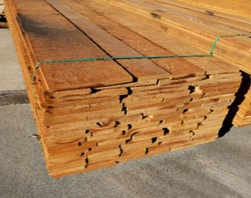
From Logs to Lumber: The NHLA Yield Analysis
Proprietary Process:
Productivity
Yield
Profitability

Slide 11
NHLA Yield Analysis Team Objective - Recover Lost Profits
100 years of experience
Notes:
The NHLA Yield Analysis Team have already proven their ability to help sawmills recover lost profits through its proprietary quality control process.

Slide 12
Introducing the NHLA Yield Analysis
$3.9 million lost profits recovered
$230,000 to $680,000 annually
$400,000 on average recovered per mill
Notes:
This is what has been achieved in the last 12 months

Slide 13
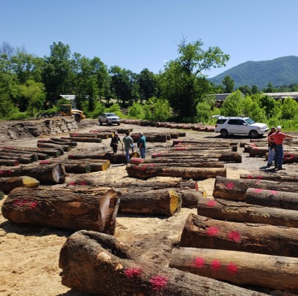
NHLA Yield Analysis
Species Specific Yield Analysis
Diameter & Grade Specific Profitability
Lumber Recovery Factor
Follow Up Visits by Inspectors to Chart Progress
Notes:
We start with your logs. What if we could offer you a 4% increase in lumber value?

Slide 14
Yield Analysis Partnership
Calibration
Machine Parameters
Yield Loss
Log Yard
Headrig
Resaw
Gang Saw
Trimmer
Notes:
Continue the program to ensure you maintain higher revenue volumes.
We show you how to make sure it doesn’t happen again.

Slide 15
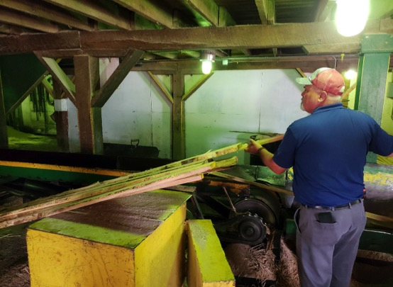
Yield Analysis Process – Education
Sawing Techniques
Edger/Trimmer
Log Scaling/Grading
Lumber Grading
Quality Control
Saw Filing

Slide 16
Industry Benchmarks
Lumber Recovery Factor
Previous Tests by USFS
Previous Tests by NHLA
Overrun
Productivity Per Hour
Board Foot Productivity
Notes:
Each participant’s values are confidential, but NHLA sees the value of creating a data base for the industry.

